Slide 1



ECOTRACK
A Tech-driven solution to address the dual threat of paper cups-Environmental Problems and Health Risks
TEAM : INFERNO

Slide 2



MEET OUR TEAM
02
SANDRA VIJUMON
SONA SABU
ASHNA D SILVIA

Slide 3
03
Problem
A Tech-driven solution to address the dual threat of paper cups-Environmental Problems and Health Risks

Slide 4
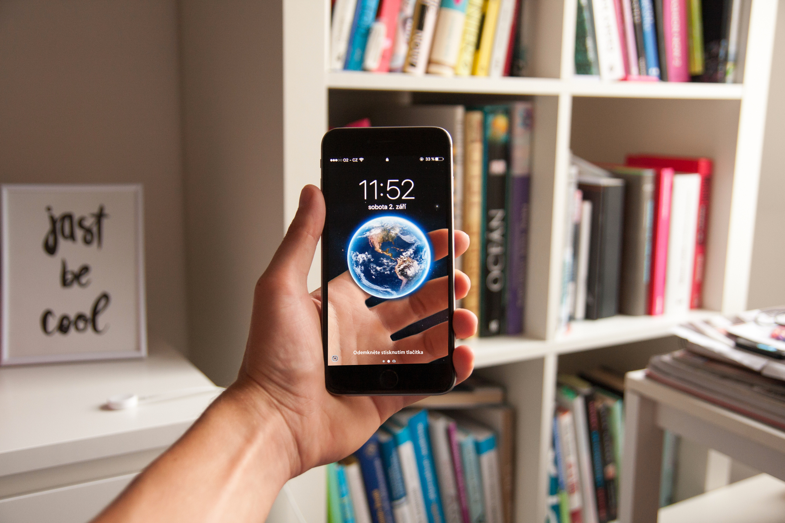
Solution
04
EcoTrack - a web application, which aims to track and reduce the environmental and health impacts of disposable paper cup usage around the College campus. The application provides a platform for users to monitor their individual and collective contributions in saving cups, reducing CO2 emissions, and preventing microplastic pollution.

Slide 5



USERS
Admin
Teachers
Students
Non teaching staffs

Slide 6
MODULES
Admin Module
User Registration and Login Module
Paper Cup Tracking Module
Impact Calculation
Awarness Module

Slide 7
Key features
06
03
Feature 3
02
Promote reusable cups and bottles made of safe, non-toxic materials (BPA-free, phthalate-free).
01
Feature 2
Feature 1
Monitor individual challenges and participation
Track personal sustainability efforts

Slide 8
08
TECHNOLOGIES USED
FRONTEND : REACT,BOOTSTRAP
BACKEND : NODE.JS,EXPRESS.JS
DATABASE : MONGODB

Slide 9
15
THANK YOU

